Slide 1
KEYS: UA HPC - (High Performance Computing)
by Eddie Contreras, BIO5 IT Team & ISTA Major
Notes:
1

Slide 2
PRESENTATION AGENDA
What is HPC? & Why use HPC?
Connecting to HPC!
Basics of working with the Linux shell & HPC!
Resources & Support
Questions and Discussions
Notes:
2

Slide 3
What is HPC? & Why use HPC?
Notes:
10

Slide 4
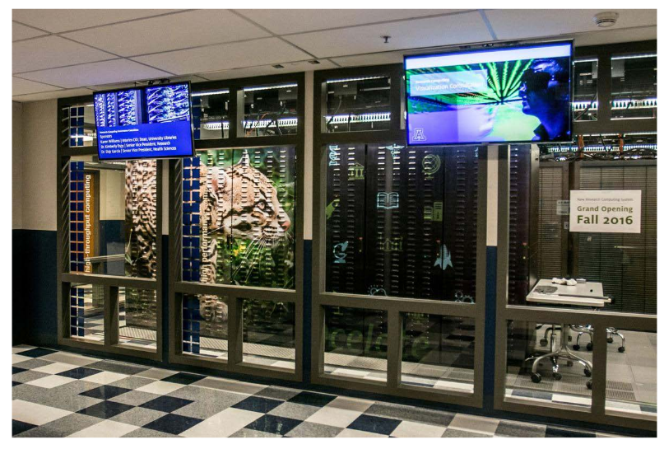
UA HPC - Ocelote
“aa-suh-laat” - is a small wild cat native to the southwestern United States, Mexico, and Central/South America.
Notes:
2

Slide 5
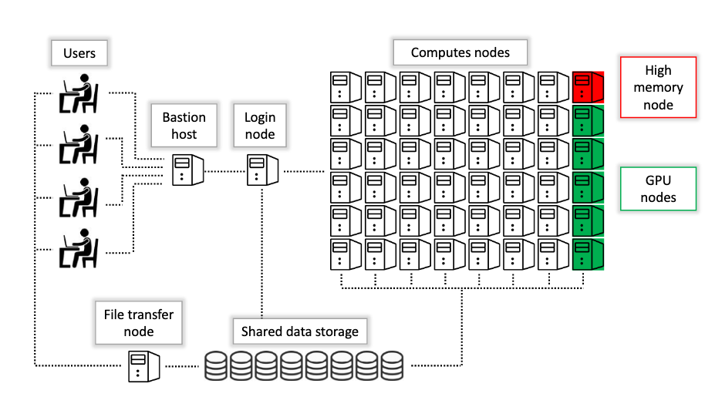
UA HPC Cluster - Diagram
“Cluster” - constists of lots of connected individual computers (nodes).
Notes:
2

Slide 6
Why use HPC?
Problem
Solution
Computation takes too long!
Computation is too big!
Too Many Calculations! :(
Assigns a specific computer just for the computation!
Divide the task between multiple computers!
Use lots of computers simultaneously :)
Sample Source: KXXX, XXXX
Notes:
16

Slide 7
Connecting to HPC!
Notes:
10

Slide 8
How to Connect:
PuTTy & Terminal / CMD Line
Web Interface
ssh NetID@hpc.arizona.edu
Enter NetID Password.. Invisible Typing.
Enter Passcode Option (#)
Visit ood.hpc.arizona.edu
Clusters Tab > Ocelote Shell Access
Sample Source: KXXX, XXXX
Notes:
16

Slide 9
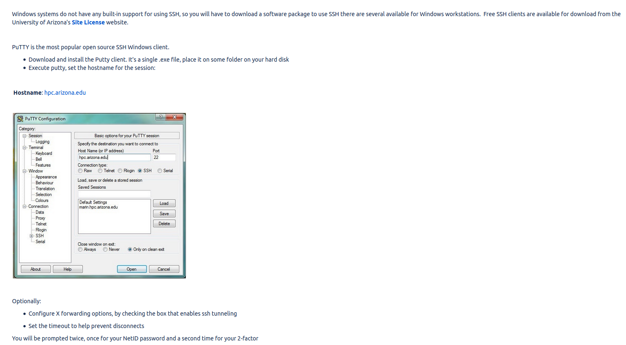
PuTTY Configuration - Windows Login!
Notes:
2

Slide 10
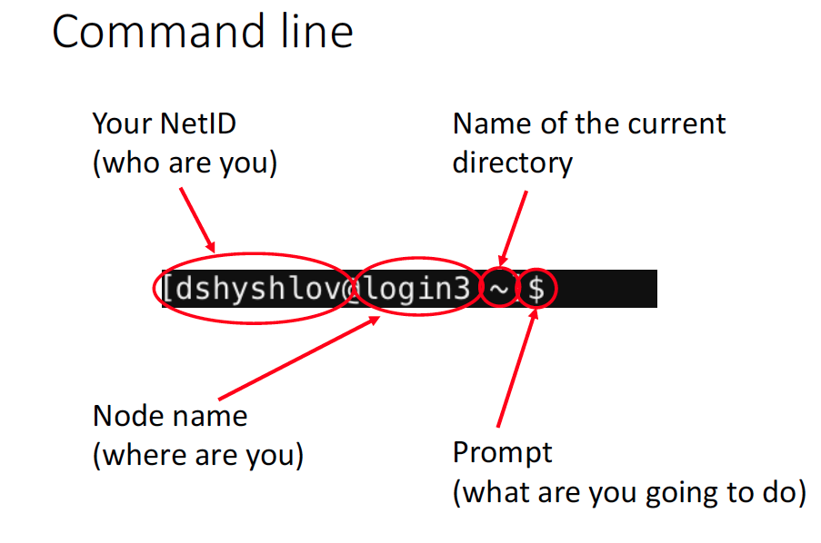
Notes:
2

Slide 11
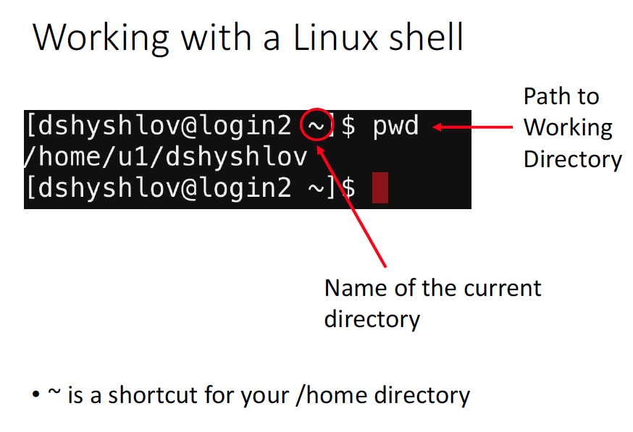

Slide 12
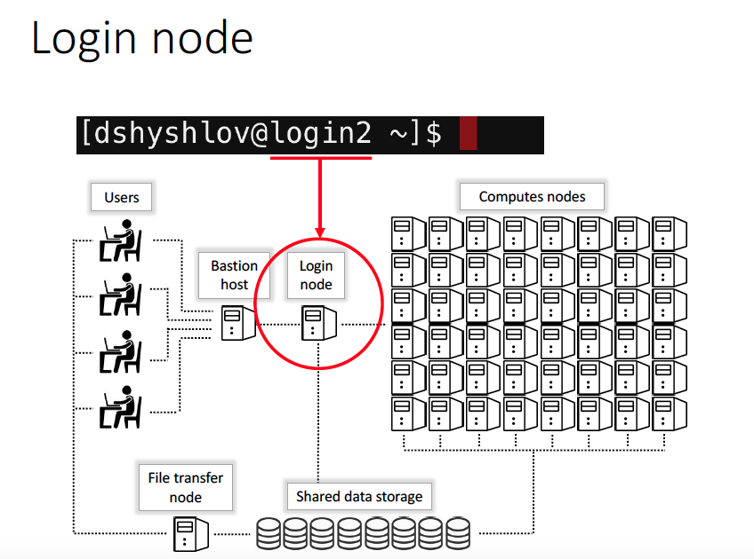
Notes:
2

Slide 13
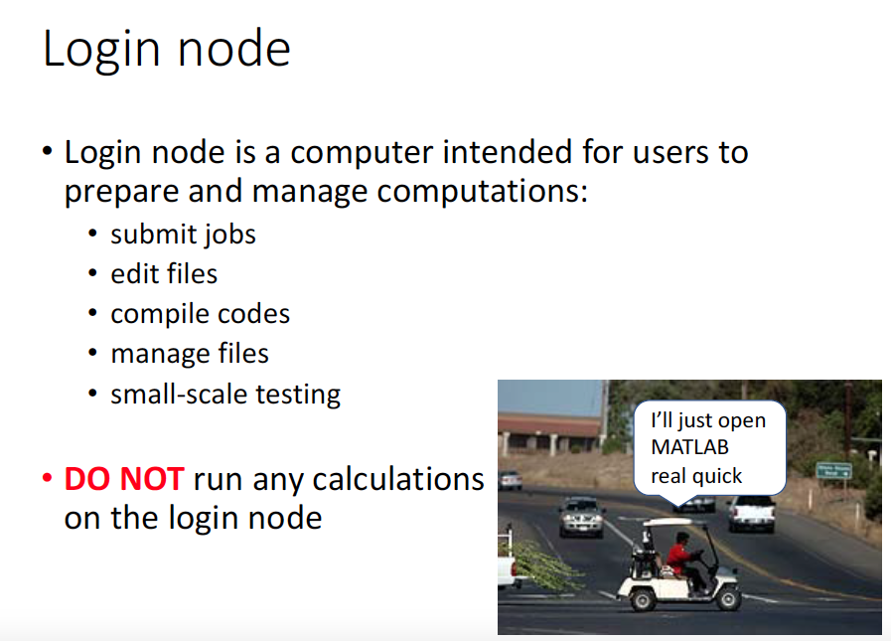

Slide 14
Helpful HPC Commands
pwd - (Path to Working Directory)
cd - (Change Directory)
ls - (List folders and files in Directory)
mkdir - (Make Directory/Folder)
mv - (Move and Copy Files)
cat filename - (View contents of the file on screen)
module avail - (Display all the software & versions installed on Ocelote)
module list - (Display the software you have loaded in your environment)
module load modulename - (Load a software module in your environment)
module purge - (Unload all software modules)
module unload modulename - (Unload specific software module)
Notes:
2

Slide 15
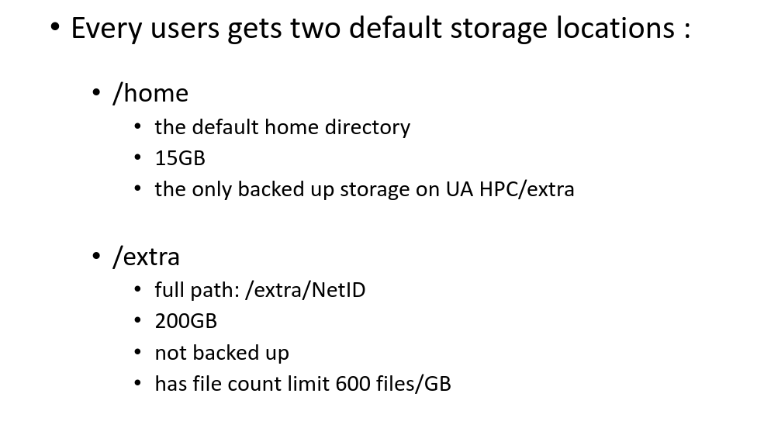
HPC Storage - File & Directory Transfers!
Notes:
2

Slide 16
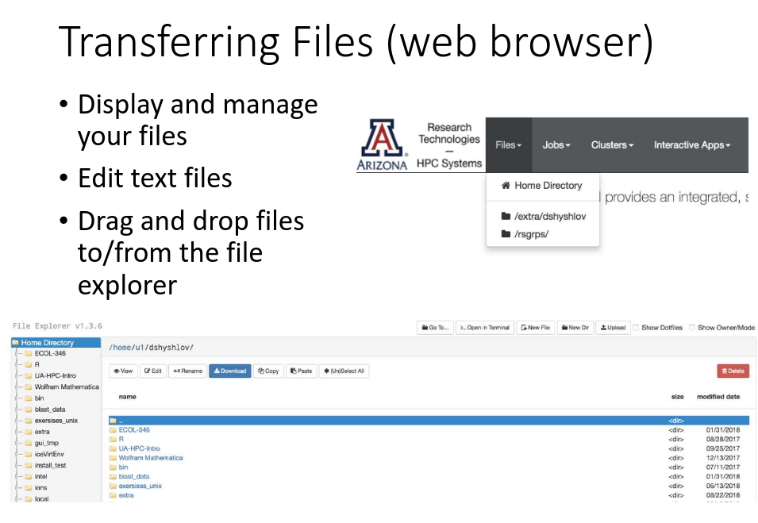
HPC Storage - File & Directory Transfers!
Notes:
2

Slide 17
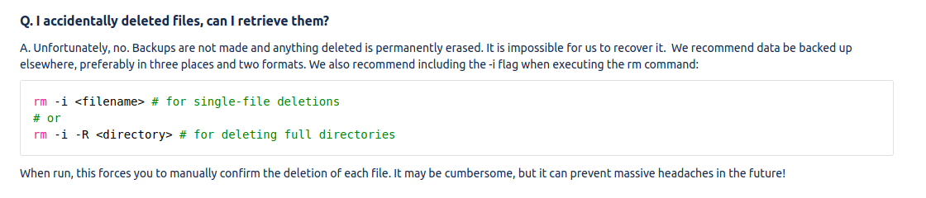
Backups, Backups and Backups!
Notes:
10

Slide 18
Resources & Support
Notes:
3

Slide 19
Resources & Support
UA HPC User Guide - ( Click Here )
UA HPC Introduction Full PowerPoint - ( Click Here )
UA HPC FAQ’s - ( Click Here )
BIO5 IT Team Support - support@bio5.org
UITS 24/7 Support - (520) 626-8324
Notes:
2

Slide 20
QUESTIONS & DISCUSSION
Notes:
17

